Slide 1

Gabriel, Hannah, Ahmed, Frank, Belinda, Aaron
By An Pai Technologies. The only technology.

Slide 2
Introduction and Overview of the Application
Brief
Passionate about discovering new food and travel
Goals
Easy and simple
Provide optimal dining experience
Provide reviews and ratings
Offer translated menus
Mobile GPS tracking
Coupons and discounts

Slide 3
The Process
Chose industry - Food
Chose Location - China
Found target users – English speaking tourists
Application features – GPS, reviews, translation …

Slide 4
The management
Gabe: Team Manager
Frank: System Architect
Hannah: Quality Control and Testing
Belinda: Business Manager
Aaron: Programmer
Ahmed: Marketing Manager

Slide 5
Solving issues
Technical (Software) Issues
Frontend
Backend
Scoping
Non-Technical Issues

Slide 6
Iteration 1 (Week 1)
WHAT
WHO
WHY
WHERE
WHEN
HOW

Slide 7
Iteration 2 (Week 2)
Changes:
WHAT
WHO
WHY
WHERE
WHEN
HOW

Slide 8
Iteration 3 (Week 3)
Changes:
WHAT
WHY
WHERE

Slide 9
Application Features
Current
Current GPS location tracking and Maps
Camera use for the forum
Login or register account
Planned
add reviews to the restaurants
add photos of the restaurants
suggest menu translations
like and dislike reviews
key word search
filtering the top recommendations
edit the profile page
ability to save/favorite restaurant for easy access
data scraping from restaurant websites
premium services
ability to comment on the reviews

Slide 10


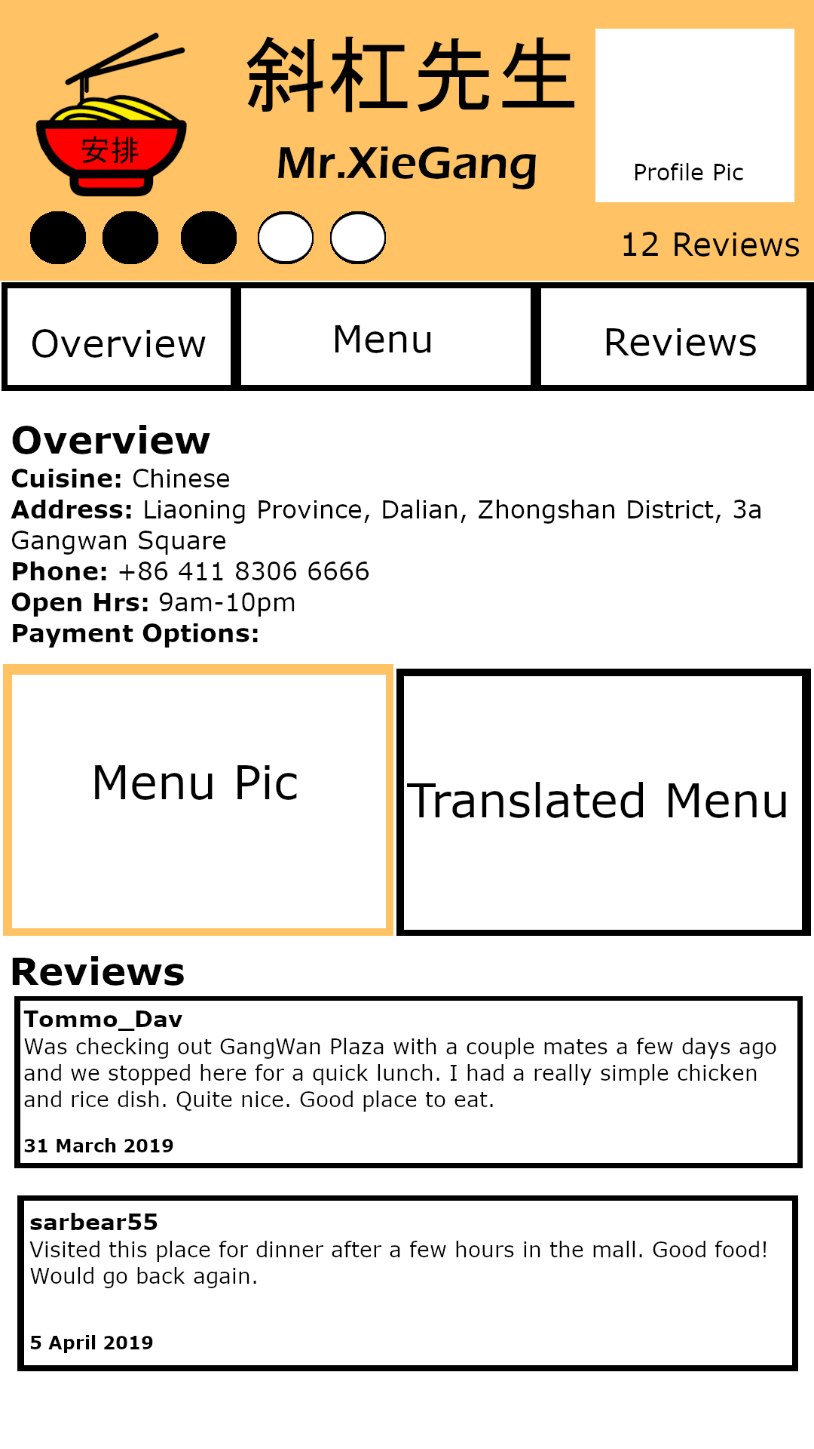

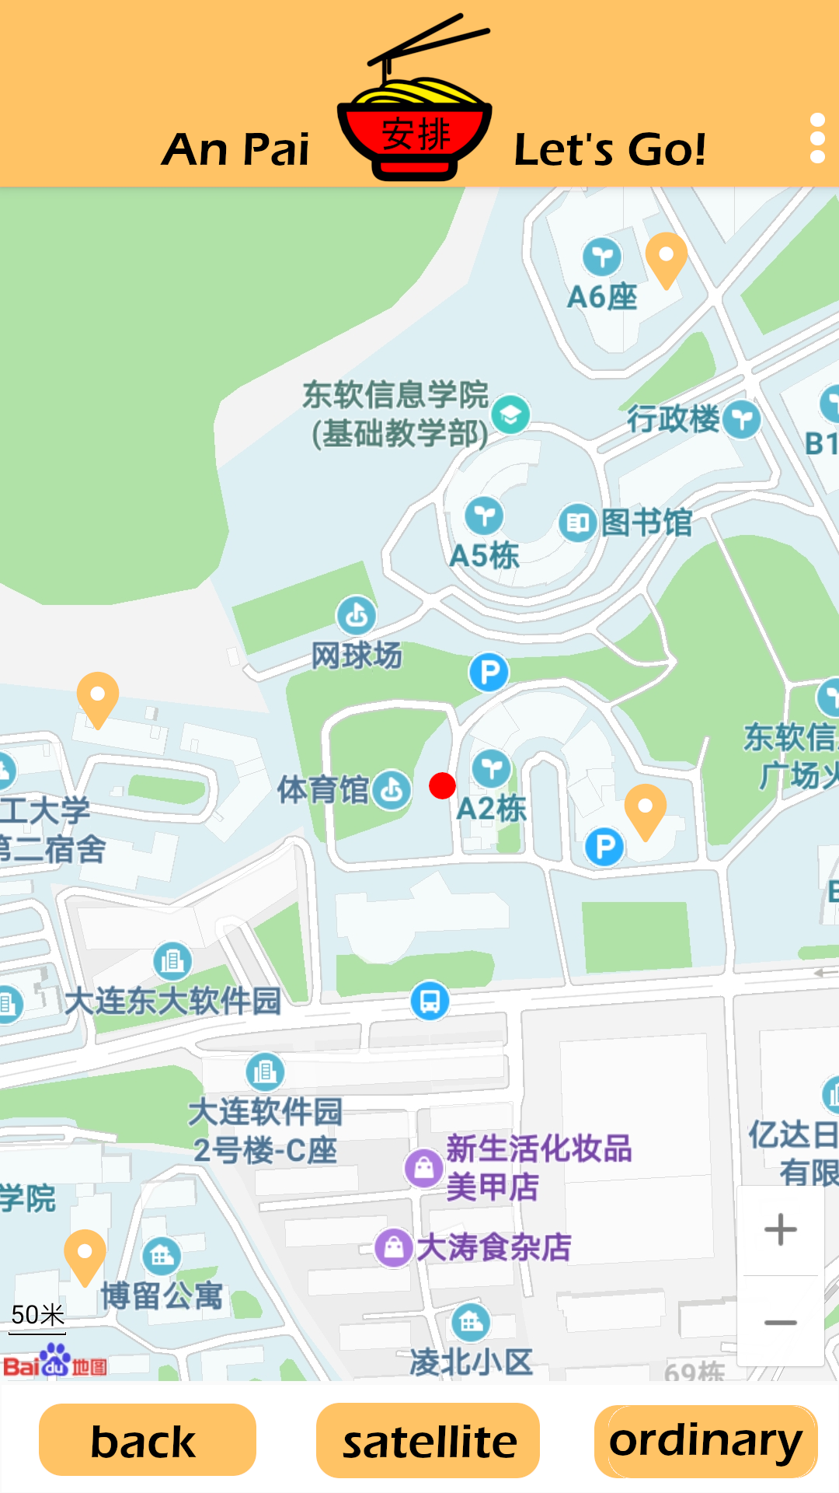
The UI design vs what we actually have
The User Interface Design

Slide 11
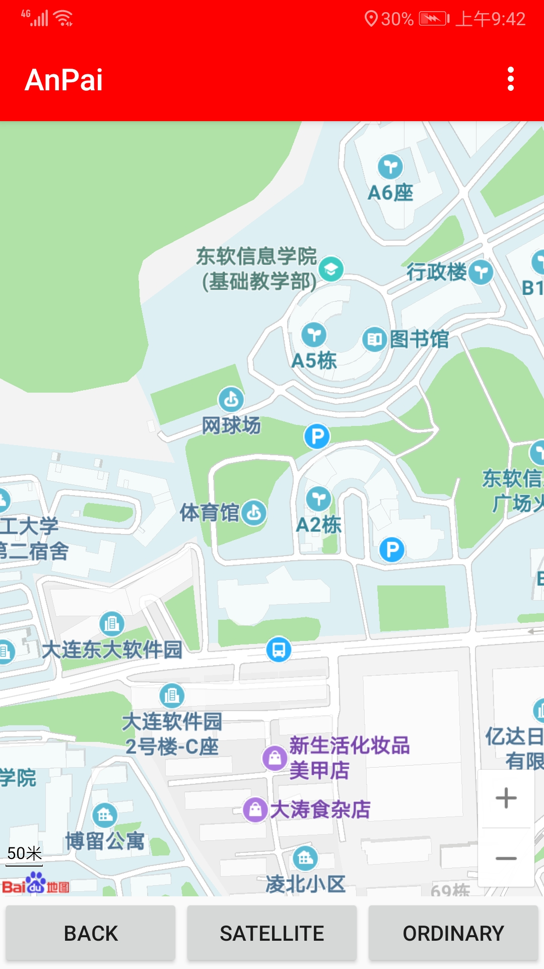
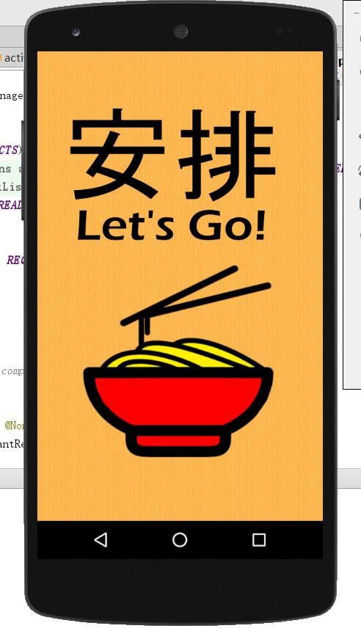
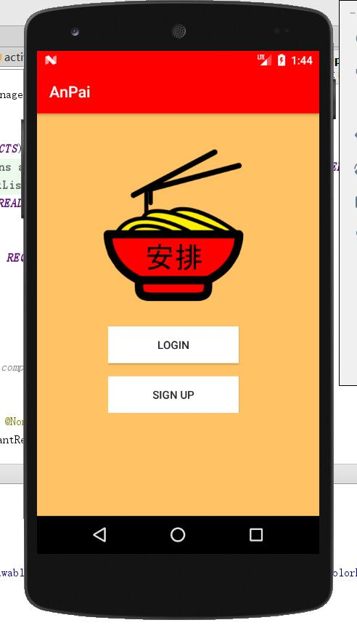
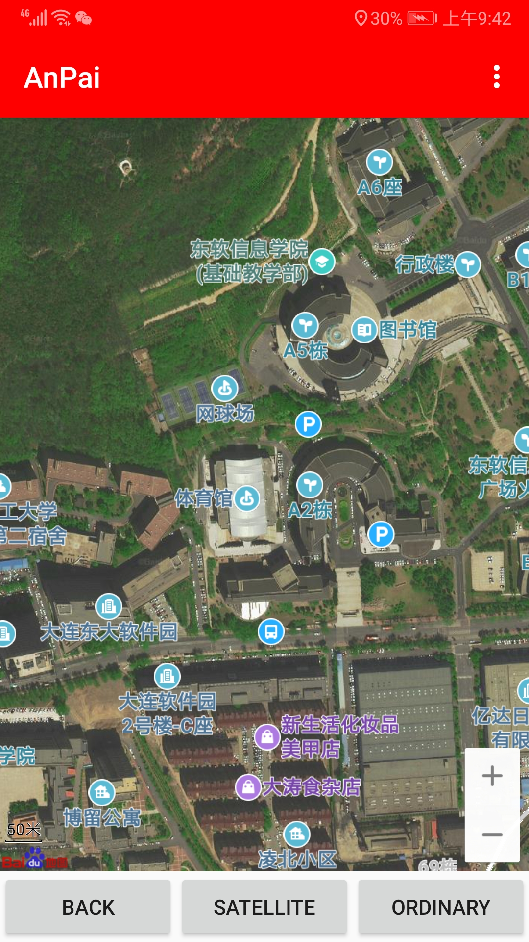
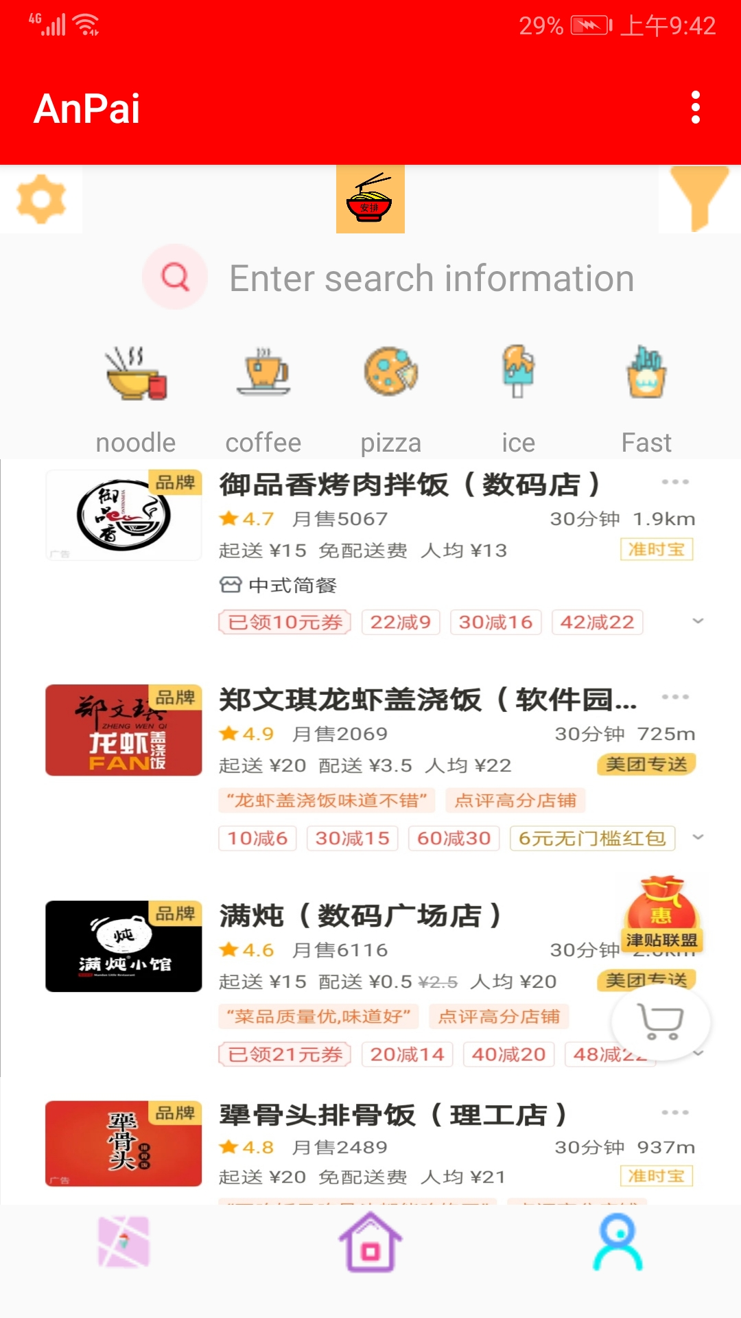
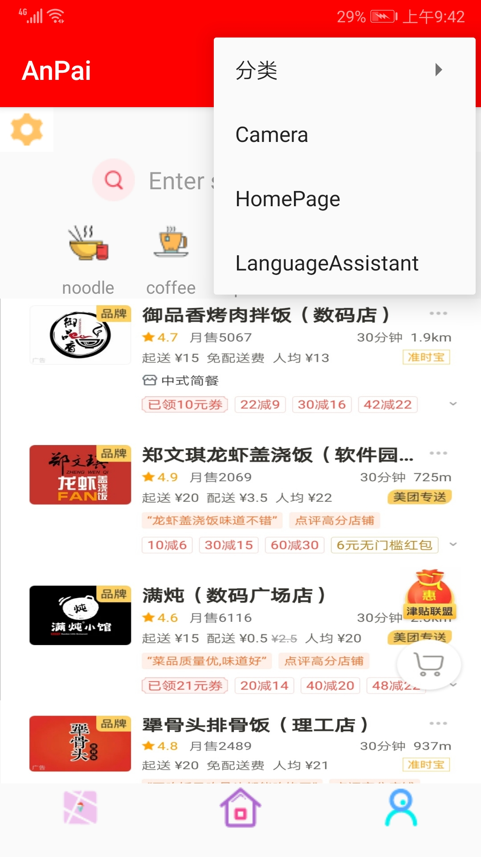
The UI design vs what we actually have
The actual application design

Slide 12
The UI design vs what we actually have
The actual application design

Slide 13
Application Demo

Slide 14
What do we have planned for the future?
Front End:
Filters
Settings
Likes and dislikes
Location tracking and filtering by distance
Password reset
Premium subscriptions
Official and unofficial pages
Customer Service

Slide 15
What do we have planned for the future?
The Backend
Translation Camera
Use of third party applications
Forum
Dynamic AI
Machine Learning
MLUPA
Security Data Protection
Optimization
Cyber security
SQL injection protection

Slide 16
THANK YOU

